Slide 1
Term Project template
GROUP:19
Name: Abdulrahman Muhammad AbdulSalam Ahmed Student ID: 300327218
Name: Amir Safwat Halim Youssef Student ID: 300327305
Name: Mohamed Khaled Ramadan Aoad Elesawy Student ID: 300327237

Slide 2
Problem’s overview (10 marks)
Provide a conceptual figure to explain the problem in hand
The figure should show an end-to-end dataflow, and provide insights on the problem
You can write a few sentences to further explain the problem, if needed
Copying and pasting the figure from online resources is not allowed

Slide 3
Problem Overview
Our objective is to
Recognize different network
Intrusion attacks so,
We first create a baseline
Model for comparison and
Then try to better its
Accuracy at detecting
Attacks by using feature
Reduction and feature
Selection and then optimizing the model structure by trying different learning rates, optimizers, layer structure and so on to solve the main problem at hand which is multi classification of Network attack types.

Slide 4
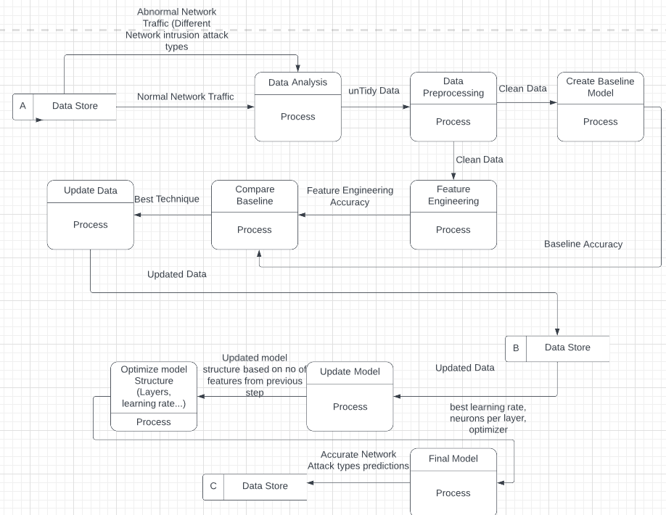
Problem Overview cont.

Slide 5
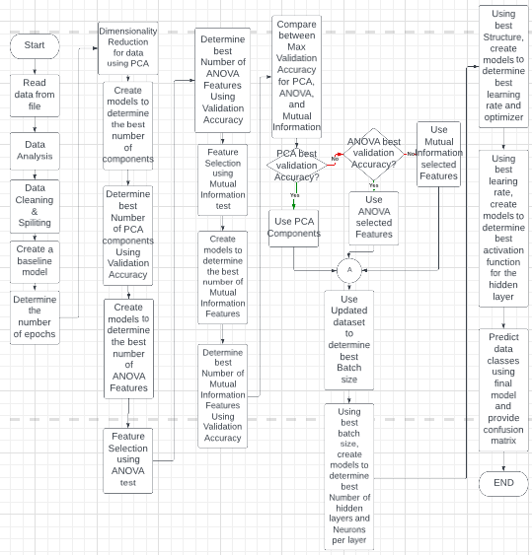
Flowchart
Provide an end-to-end flowchart, where you show every step in the process of the project’s implementation.

Slide 6
Dataset’s overview (EDA) (10 marks)
Briefly study the dataset and provide your insights and any relevant information. That includes, but not limited to:
Number of instances per class
Number of null values per feature
Number of possible outliers
Basic statistical analysis for every feature (mean, std, min, max)

Slide 7
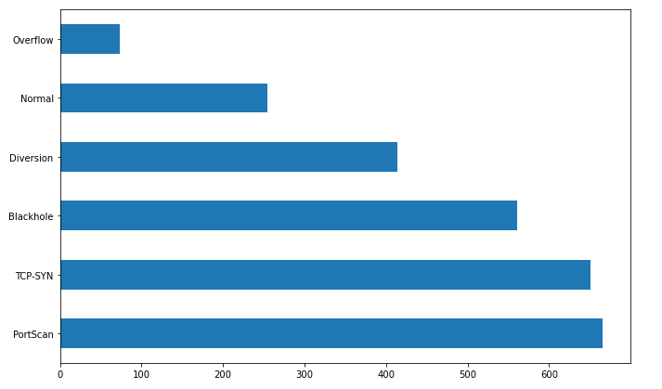
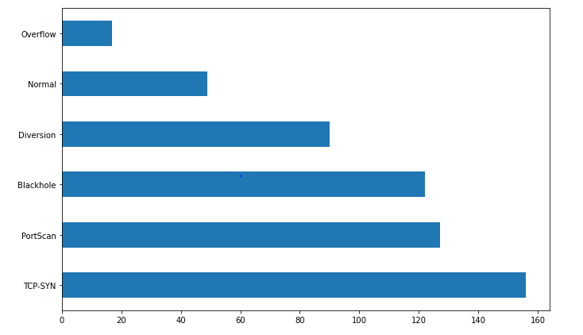
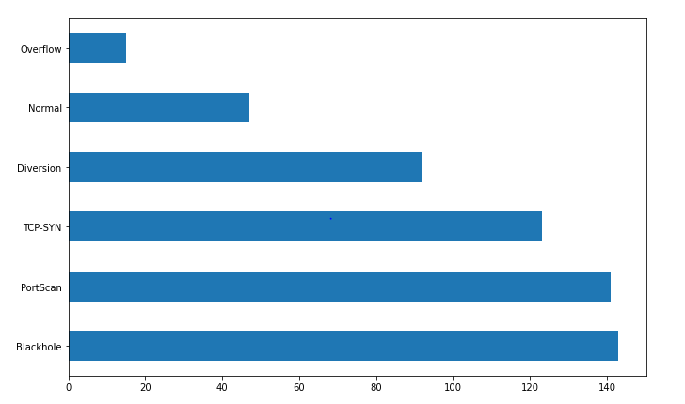
EDA 1
Training dataset testing dataset validation dataset

Slide 8
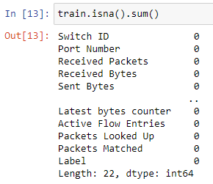
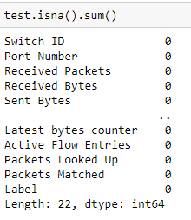
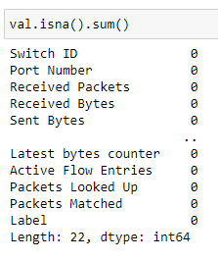
EDA 1
Training dataset testing dataset validation dataset

Slide 9
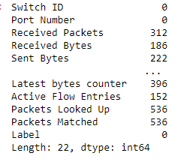
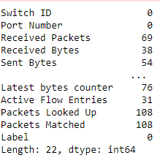
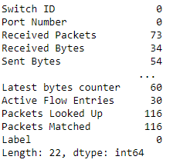
EDA 1
Training dataset testing dataset validation dataset

Slide 10
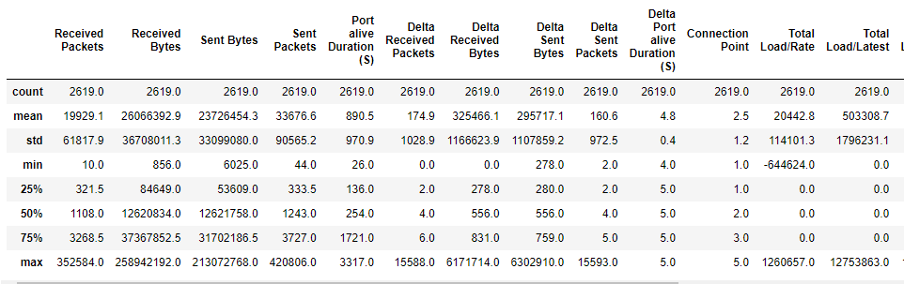
EDA 1 cont.

Slide 11
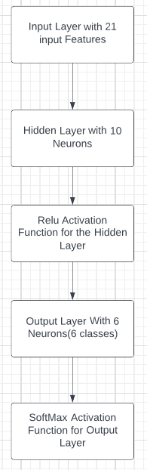
Q1.1
Build MLP Classifier

Slide 12
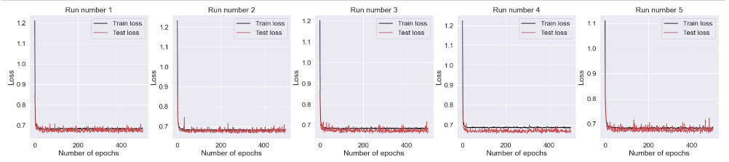
Q1.2

Slide 13
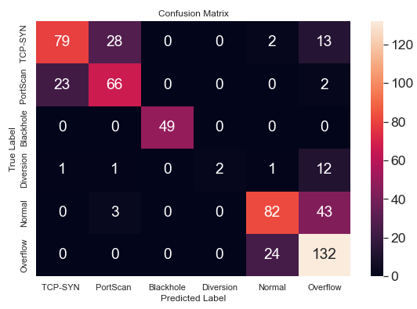
Q1.3
Max training acc | Max test acc | Min training acc | Min test acc | Avg training acc | Avg test acc
0.7384498119354248 | 0.7522281408309937 | 0.4940817058086395 | 0.698752224445343 | 0.7246883550286293 | 0.7290552496910095

Slide 14
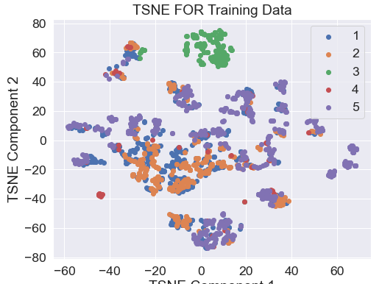
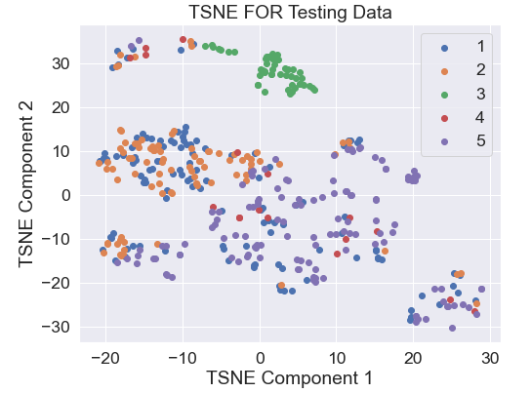
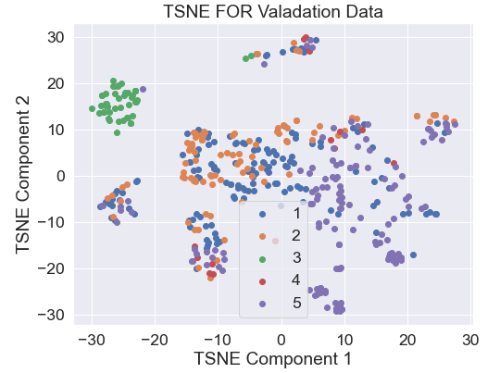
Q1.4
Training dataset testing dataset validation dataset

Slide 15
Q1) Obtain a baseline performance (10 marks)
Build an MLP classifier using the provided dataset and the following parameters: (4 marks)
1 hidden layers with 10 neurons
Relu activation function
Use AdamW optimizer and set the learning rate as 0.001
# of epochs=500
Batch size =1
Plot the training and testing losses vs. the number of epochs (2 marks)
Complete the table below, and provide the confusion matrix based on the average test accuracy (2 marks)
Provide 2D TSNE plots, one for the training set, one for the test set, and one for the validation (2 marks)
Max training acc | Max test acc | Min training acc | Min test acc | Avg training acc | Avg test acc
0.3627338707447052 | 0.22638146579265594 | 0.2149675488471985 | 0.22638146579265594 | 0.24953738101124764 | 0.22638146579265594

Slide 16
Q2) Compre dimensionality reduction to feature selection
Q2.1) Dimensionality reduction (6 marks)
Find the best value for n_components based on the test accuracy of the MLP classifier, using Principal Component Analysis,
PCA(n_components=n, random_state=0)
Plot the (number of component-test accuracy) graph with the baseline performance.
Apply TSNE(n_components=2, random_state=0) to visualise the training and test datasets after DR
Q2.2) Feature selection (6 marks)
Find the best number of features based on the MLP test accuracy, using the feature selection methods:
ANOVA
Mutual Information
Choose the method that achieves the best test accuracy results (either the ANOVA or mutual information), and provide 2D TSNE plots, one for the training set and one for the test set.
Update your dataset, to be used in the next steps, based on the technique that provides you with highest validation accuracy (either dimensionality reduction or feature selection), and provide the confusion matrix. (3 marks)

Slide 17
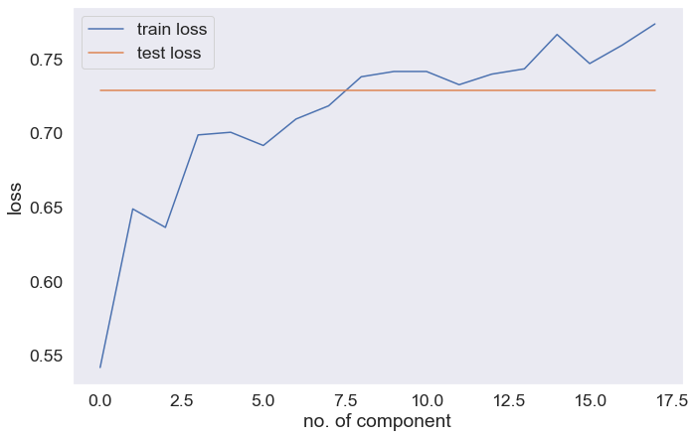
Q2.1
Dimensionality Reduction
the best pca accuracy = 0.7736185193061829 and the best value for n_components based on the test accuracy is 19
the best Pca index =0.782531201839447 best value for n_components 19
On validation dataset.

Slide 18
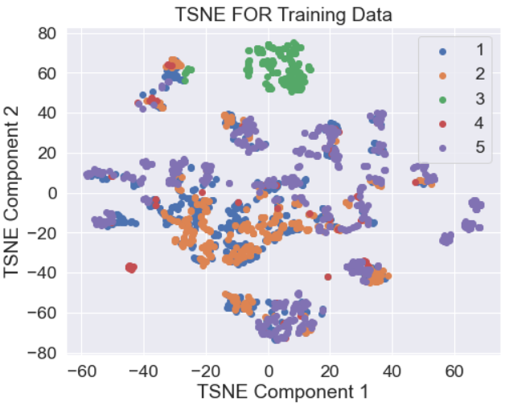
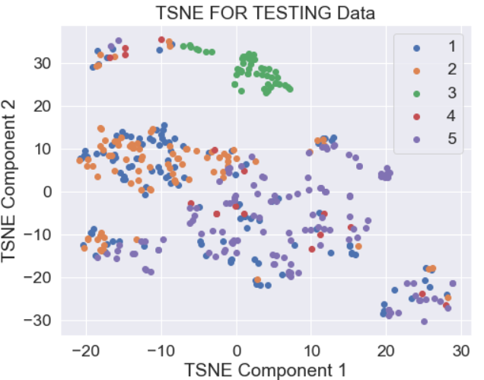
Q 2.1 cont
TSNE for Both Training and Testing data

Slide 19
Q 2.2
Feature Selection
1-
the best anvoa acc =0.7896613478660583 best value for n_components 11
the best mutual acc =0.7664884328842163 best value for n_components 19
Both are on test set
2-
the best anvoa val index =0.7860962748527527 best value for n_components 9
the best mutual index =0.77183598279953 best value for n_components 18
Anova is best in both test and validation datasets so
We draw TSNE Plots based on it.

Slide 20
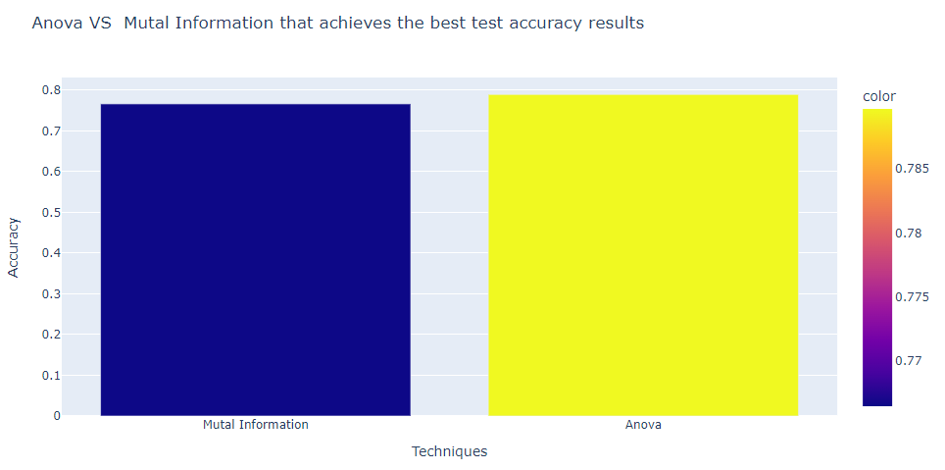

Slide 21
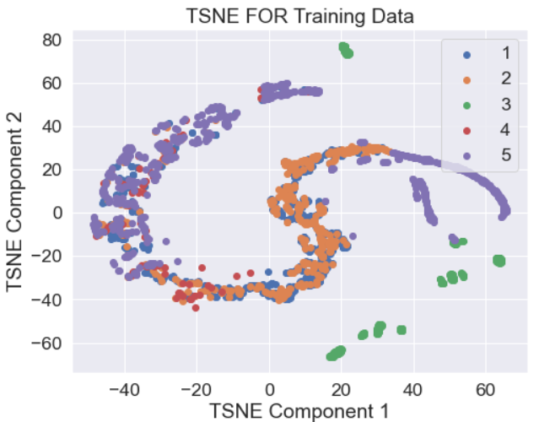
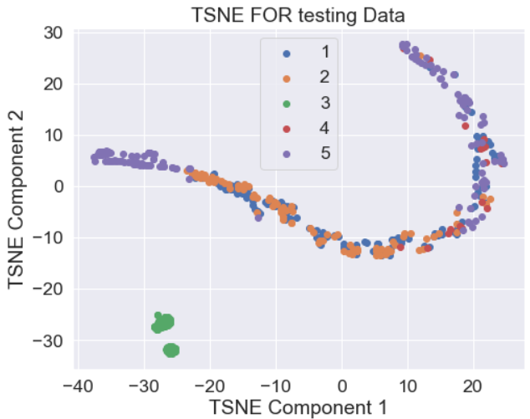
Q 2.2 cont.
TSNE Plots for both training and testing datasets

Slide 22
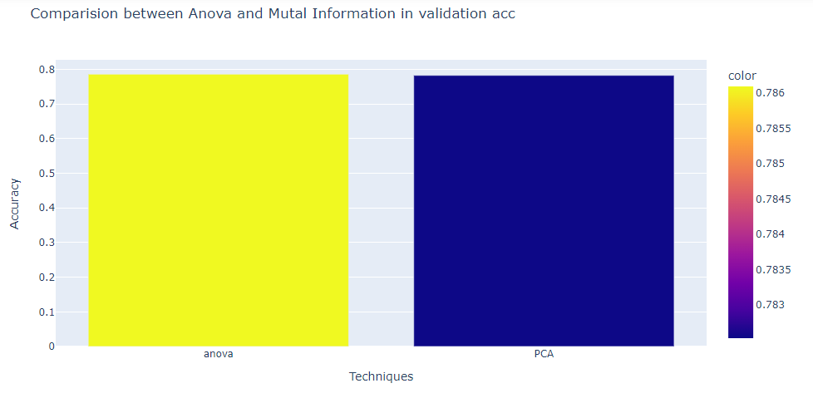

Slide 23
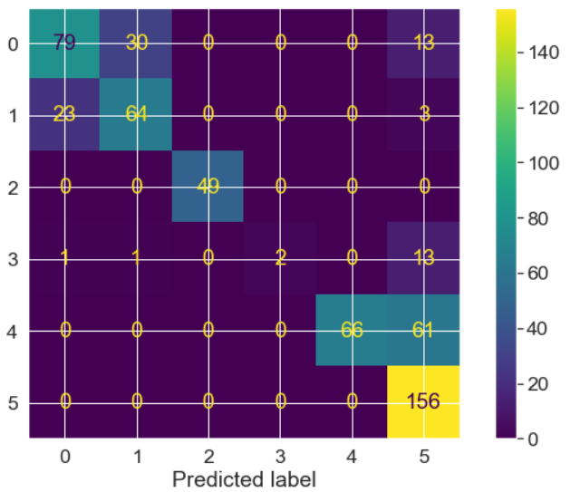
Confusion matrix based on best technique

Slide 24
Q3) Vary the MLP parameters [1/5]
Q3.1) Batch size
Using the same parameter the batch size =128 had the same training accuracy as when the batch was = 32 but had a better test accuracy .even though batch =64 had a higher number of batches it wasn’t better than the batch =32 from this we could conclude that the batch size alone will not increase the accuracy but it have a good impact on the running time
And the one that the highest average validation accuracy was batch = 32 so we will use it in the next part
Batch size= 32 |  |  |  |  |  | Batch size= 64 |  |  |  |  |  | Batch size= 128
Max train acc | Max test acc | Min train acc | Min test acc | Avg train acc | Avg test acc | Max train acc | Max test acc | Min train acc | Min test acc | Avg train acc | Avg test acc | Max train acc | Max test acc | Min train acc | Min test acc | Avg train acc | Avg test acc
0.7678 | 0.7718 | 0.7552 | 0.7522 | 0.7624 | 0.7622 | 0.7644 | 0.7682 | 0.7506 | 0.7468 | 0.7579 | 0.7590 | 0.7762 | 0.7807 | 0.7449 | 0.7486 | 0.7624 | 0.7629

Slide 25
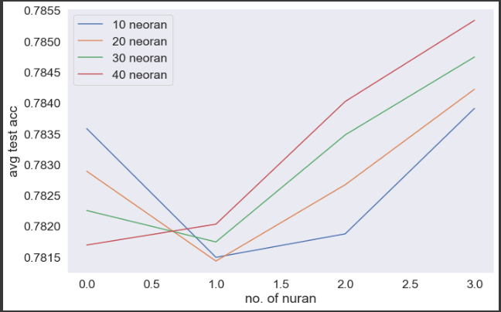
Q3.2) Hidden layers vs. neurons/layer
This the plot that shows the relation between the number of neuron and the accuracy over different no. layers from this we could conclude that having more neuron will make the model able to have more accuracy
 | 1 hidden layer |  |  |  |  |  | 2 hidden layer |  |  |  |  |  | 4 hidden layer |  |  |  |  |  | 8 hidden layer
# of neurons for each layer | Max train acc | Max test acc | Min train acc | Min test acc | Avg train acc | Avg test acc | Max train acc | Max test acc | Min train acc | Min test acc | Avg train acc | Avg test acc | Max train acc | Max test acc | Min train acc | Min test acc | Avg train acc | Avg test acc | Max train acc | Max test acc | Min train acc | Min test acc | Avg train acc | Avg test acc
10 | 0.8247 | 0.8342 | 0.6964 | 0.7254 | 0.7764 | 0.7835 | 0.8247 | 0.8342 | 0.6964 | 0.7254 | 0.7748 | 0.7814 | 0.8247 | 0.8342 | 0.6964 | 0.7254 | 0.7752 | 0.7818 | 0.8247 | 0.8342 | 0.6964 | 0.7254 | 0.7771 | 0.7839
20 | 0.8247 | 0.8342 | 0.6964 | 0.7254 | 0.7759 | 0.7828 | 0.8247 | 0.8342 | 0.6964 | 0.7254 | 0.7749 | 0.7814 | 0.8247 | 0.8342 | 0.6964 | 0.7254 | 0.7758 | 0.7826 | 0.8247 | 0.8342 | 0.6964 | 0.7254 | 0.7772 | 0.7842
30 | 0.8247 | 0.8342 | 0.6964 | 0.7254 | 0.7754 | 0.7822 | 0.8247 | 0.8342 | 0.6964 | 0.7254 | 0.7751 | 0.7817 | 0.8247 | 0.8342 | 0.6964 | 0.7254 | 0.7765 | 0.7834 | 0.8247 | 0.8342 | 0.6964 | 0.7254 | 0.77762 | 0.7847
40 | 0.8247 | 0.8342 | 0.6964 | 0.7254 | 0.7749 | 0.7816 | 0.8247 | 0.8342 | 0.6964 | 0.7254 | 0.7753 | 0.7820 | 0.8247 | 0.8342 | 0.6964 | 0.7254 | 0.7771 | 0.7840 | 0.8247 | 0.8360 | 0.6964 | 0.7254 | 0.7780 | 0.7853

Slide 26
Q3.2) cont.
We found that having more neuron and hidden layers raised both the average of the training and testing accuracy also it had the highest average validation accuracy, so we used it in the next question
 | 1 hidden layer |  |  |  |  |  | 2 hidden layer |  |  |  |  |  | 4 hidden layer |  |  |  |  |  | 8 hidden layer
# of neurons for each layer | Max train acc | Max test acc | Min train acc | Min test acc | Avg train acc | Avg test acc | Max train acc | Max test acc | Min train acc | Min test acc | Avg train acc | Avg test acc | Max train acc | Max test acc | Min train acc | Min test acc | Avg train acc | Avg test acc | Max train acc | Max test acc | Min train acc | Min test acc | Avg train acc | Avg test acc
10 | 0.8247 | 0.8342 | 0.6964 | 0.7254 | 0.7764 | 0.7835 | 0.8247 | 0.8342 | 0.6964 | 0.7254 | 0.7748 | 0.7814 | 0.8247 | 0.8342 | 0.6964 | 0.7254 | 0.7752 | 0.7818 | 0.8247 | 0.8342 | 0.6964 | 0.7254 | 0.7771 | 0.7839
20 | 0.8247 | 0.8342 | 0.6964 | 0.7254 | 0.7759 | 0.7828 | 0.8247 | 0.8342 | 0.6964 | 0.7254 | 0.7749 | 0.7814 | 0.8247 | 0.8342 | 0.6964 | 0.7254 | 0.7758 | 0.7826 | 0.8247 | 0.8342 | 0.6964 | 0.7254 | 0.7772 | 0.7842
30 | 0.8247 | 0.8342 | 0.6964 | 0.7254 | 0.7754 | 0.7822 | 0.8247 | 0.8342 | 0.6964 | 0.7254 | 0.7751 | 0.7817 | 0.8247 | 0.8342 | 0.6964 | 0.7254 | 0.7765 | 0.7834 | 0.8247 | 0.8342 | 0.6964 | 0.7254 | 0.77762 | 0.7847
40 | 0.8247 | 0.8342 | 0.6964 | 0.7254 | 0.7749 | 0.7816 | 0.8247 | 0.8342 | 0.6964 | 0.7254 | 0.7753 | 0.7820 | 0.8247 | 0.8342 | 0.6964 | 0.7254 | 0.7771 | 0.7840 | 0.8247 | 0.8360 | 0.6964 | 0.7254 | 0.7780 | 0.7853

Slide 27
Q3.3) Learning rate and different optimizers
 | Learning rate=0.1 |  |  |  |  |  | Learning rate=0.01 |  |  |  |  |  | Learning rate=0.001
optimizer | Max train acc | Max test acc | Min train acc | Min test acc | Avg train acc | Avg test acc | Max train acc | Max test acc | Min train acc | Min test acc | Avg train acc | Avg test acc | Max train acc | Max test acc | Min train acc | Min test acc | Avg train acc | Avg test acc
AdamW | 0.4822 | 0.4509 | 0.2584 | 0.2174 | 0.3224 | 0.2852 | 0.7731 | 0.8074 | 0.7369 | 0.7040 | 0.7490 | 0.7508 | 0.7972 | 0.8217 | 0.7819 | 0.7950 | 0.7911 | 0.8074
SGD (momentum =0.1) | 0.7640 | 0.7985 | 0.7296 | 0.7486 | 0.7432 | 0.7693 | 0.7636 | 0.7878 | 0.7510 | 0.7504 | 0.7595 | 0.7732 | 0.7701 | 0.7878 | 0.7407 | 0.7450 | 0.7578 | 0.7639
SGD (momentum =0.5) | 0.7835 | 0.8092 | 0.7151 | 0.7397 | 0.772 | 0.7715 | 0.7888 | 0.8092 | 0.7491 | 0.7611 | 0.7673 | 0.7807 | 0.7510 | 0.7700 | 0.7380 | 0.7433 | 0.7421 | 0.7590
SGD (momentum =0.9) | 0.7842 | 0.8039 | 0.7571 | 0.7575 | 0.7715 | 0.7821 | 0.7747 | 0.7878 | 0.7346 | 0.7468 | 0.7534 | 0.7682 | 0.7644 | 0.7789 | 0.7411 | 0.7593 | 0.7510 | 0.7657
Rprop | 0.3318 | 0.3689 | 0.2562 | 0.2174 | 0.2859 | 0.3069 | 0.7670 | 0.8003 | 0.7296 | 0.7344 | 0.7539 | 0.7725 | 0.8109 | 0.8199 | 0.7731 | 0.7771 | 0.78579 | 0.7932

Slide 28
Q3.3) cont.
The model that had the highest average training and testing accuracy was AdamW with .001 learning rate .
But for the validation the RMSprop had the highest value .

Slide 29
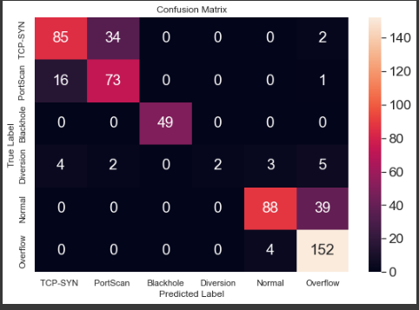
Q3.4) Activation functions
Relu |  |  |  |  |  | Leaky Relu |  |  |  |  |  | Sigmoid |  |  |  |  |  | Tanh
Max train acc | Max test acc | Min train acc | Min test acc | Avg train acc | Avg test acc | Max train acc | Max test acc | Min train acc | Min test acc | Avg train acc | Avg test acc | Max train acc | Max test acc | Min train acc | Min test acc | Avg train acc | Avg test acc | Max train acc | Max test acc | Min train acc | Min test acc | Avg train acc | Avg test acc
0.804 | 0.832 | 0.776 | 0.795 | 0.7909 | 0.8153 | 0.790 | 0.8021 | 0.7579 | 0.768 | 0.780 | 0.790 | 0.515 | 0.556 | 0.499 | 0.5151 | 0.5036 | 0.531 | 0.811 | 0.8217 | 0.774 | 0.7950 | 0.7909 | 0.809
Relu had the highest test accuracy between all the activation function

Slide 30
Q3.5) Bonus question
After the hyper parameter tuning
Max train acc | Max test acc | Min train acc | Min test acc | Avg train acc | Avg test acc
0.8205 | 0.8520 | 0.7709 | 0.7682 | 0.7996 | 0.8173

Slide 31
Conclusion
From our work on this project, we concluded that every step in the working flow will detriment the outcome of the model and judging on only the test and training is not enough
Also running the model only once is not enough as a source of information
Finally, the relationship between the running sped and the outcome not always running longer means higher accuracy early stopping may be better

